Slide 1
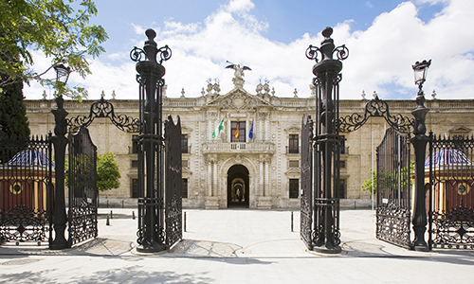

Desing and Testing Generic Controller Group 6

Slide 2

Roadmap
Foundations
Versions
CRUD
Demo
Questions

Slide 3

Roadmap
Foundations
Versions
CRUD
Demo
Questions

Slide 4
Foundations
Too many code
Forget params
Show vs Edit
Save and Delete are pre-prepared

Slide 5
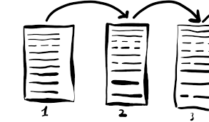
Roadmap
Foundations
Versions
CRUD
Demo
Questions

Slide 6
Versions
Generic Controller
Preliminar
Form objets vs Entities
Entities name

Slide 7
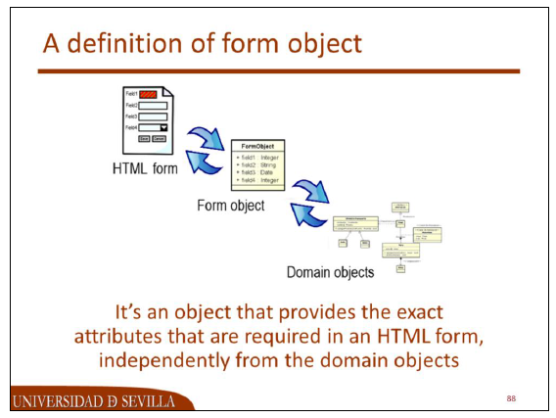
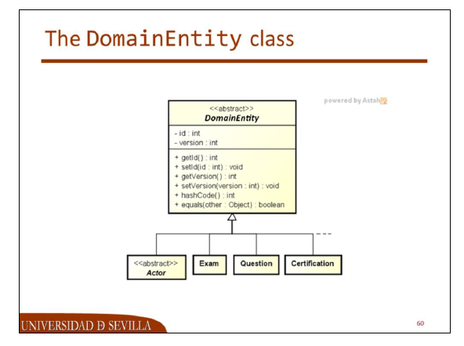
Versions – Form Objects

Slide 8
Versions – Entities Name
public <T> String nameEntity(final T e) {
String s = e.getClass().getSimpleName();
s = s.replace(s.charAt(0), Character.toLowerCase(s.charAt(0)));
if (e instanceof ActorForm)
s = "actor";
return s;
}

Slide 9

Roadmap
Foundations
Versions
CRUD
Demo
Questions

Slide 10
CRUD – Create - Edit
public abstract <T> ModelAndView saveAction(T e, BindingResult binding, String nameResolver);
public <T> ModelAndView create(final T e, final String nameView, final String requestURI, final String requestCancel) {
return this.createAndEditModelAndView(e, nameView, requestURI, requestCancel);
}
public <T> ModelAndView edit(final T e, final String nameView, final String requestURI, final String requestCancel) {
ModelAndView result;
result = this.createAndEditModelAndView(e, nameView, requestURI, requestCancel);
result.addObject("view", false);
return result;
}

Slide 11
CRUD – Save
public <T> ModelAndView save(final T e, final BindingResult binding, final String error, final String nameView, final String requestURI, final String requestCancel, final String nameResolver) {
ModelAndView result = null;
try {
result = this.custom(this.saveAction(e, binding, nameResolver));
} catch (final ValidationException valid) {
result = this.createAndEditModelAndView(e, nameView, requestURI, requestCancel);
result.addObject("view", false);
if (e instanceof ActorForm)
result.addObject("makes", super.creditCardMakes());
} catch (final Throwable oops) {
result = this.createAndEditModelAndView(e, error, nameView, requestURI, requestCancel);
result.addObject("view", false);
if (e instanceof ActorForm)
result.addObject("makes", super.creditCardMakes());
result.addObject("duplicate", true);
}
return result;
}

Slide 12
CRUD - Delete
public abstract <T> ModelAndView deleteAction(T e, String nameResolver);
public <T> ModelAndView delete(final T e, final String error, final String nameView, final String requestURI, final String requestCancel, final String nameResolver) {
ModelAndView result;
try {
result = this.custom(this.deleteAction(e, nameResolver));
} catch (final Throwable oops) {
result = this.createAndEditModelAndView(e, error, nameView, requestURI, requestCancel);
}
return result;
}

Slide 13
CRUD - List
public <T> ModelAndView listModelAndView(final String nameCollection, final String nameView, final Collection<T> objects, final String requestURI) {
ModelAndView result;
result = this.custom(new ModelAndView(nameView));
result.addObject(nameCollection, objects);
result.addObject("requestURI", requestURI);
return result;
}

Slide 14
CRUD – Other Methods
protected <T> ModelAndView createAndEditModelAndView(final T e, final String message, final String nameView, final String requestURI, final String requestCancel) {
ModelAndView result;
result = new ModelAndView(nameView);
result.addObject(this.nameEntity(e), e);
result.addObject("message", message);
this.editFormsUrlId(requestURI, requestCancel, result);
return this.custom(result);
}

Slide 15

Roadmap
Foundations
Versions
CRUD
Demo
Questions

Slide 16
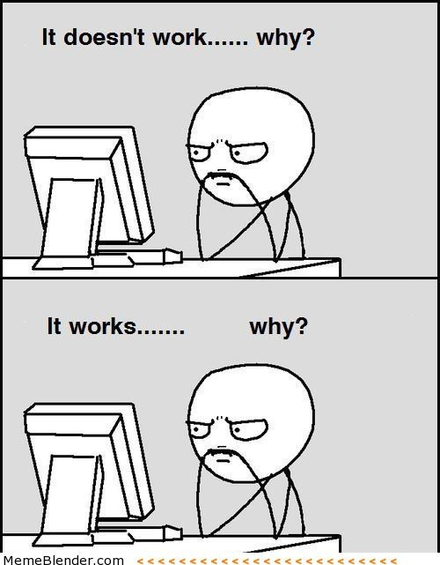

Questions

